Slide 1
The Post Correspondence Problem

Slide 2

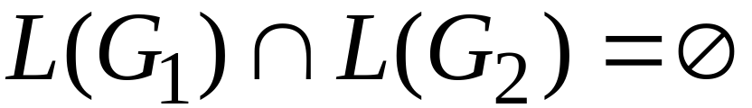
Some undecidable problems for
context-free languages:
Is context-free grammar ambiguous?
Is ?

Slide 3
We need a tool to prove that the previous
problems for context-free languages
are undecidable:
The Post Correspondence Problem

Slide 4
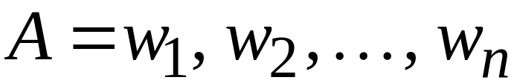
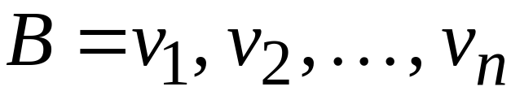
The Post Correspondence Problem
Input:
Two sequences of strings

Slide 5
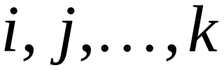
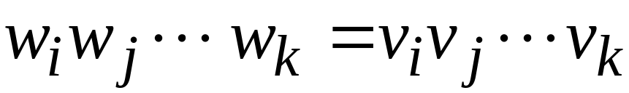
There is a Post Correspondence Solution
if there is a sequence such that:
PC-solution

Slide 6

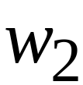
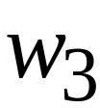










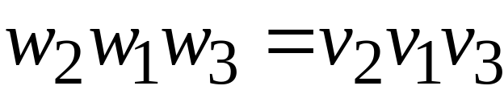

Example:
PC-solution:

Slide 7






Example:
There is no solution
Because total length of strings from
is smaller than total length of strings from

Slide 8
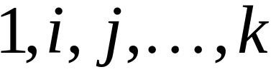
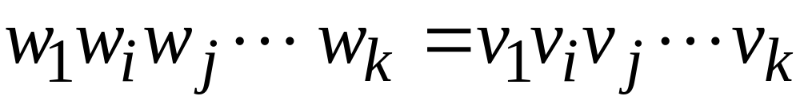
The Modified Post Correspondence Problem
Inputs:
MPC-solution:

Slide 9

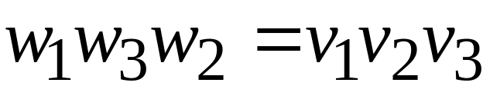
Example:
MPC-solution:

Slide 10
1. We will prove that the
MPC problem is undecidable
2. We will prove that the
PC problem is undecidable

Slide 11
1. We will prove that the
MPC problem is undecidable
We will reduce the membership problem
to the MPC problem

Slide 12



Membership problem
Input: recursive language
string
Question:
Undecidable

Slide 13

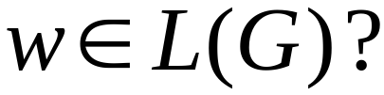
Membership problem
Input: unrestricted grammar
string
Question:
Undecidable

Slide 14


The reduction of the membership problem
to the MPC problem:
For unrestricted grammar and string
we construct a pair such that
has an MPC-solution
if and only if

Slide 15





Grammar
: start variable
: special symbol
For every symbol
For every variable

Slide 16






Grammar
string
: special symbol
For every production

Slide 17
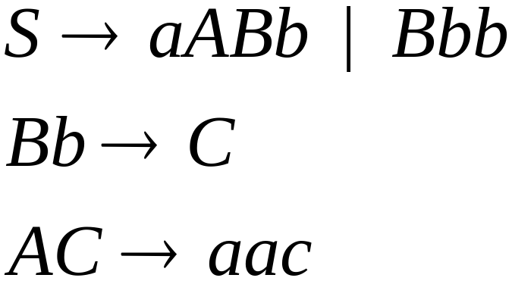

Example:
Grammar :
String

Slide 18

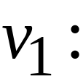
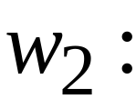
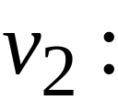




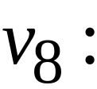

Slide 19
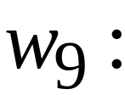

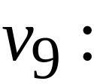






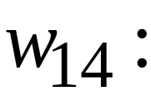
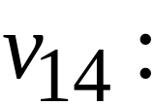

Slide 20
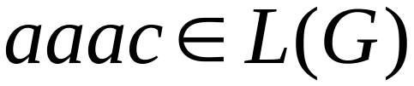
Grammar :

Slide 21

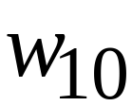
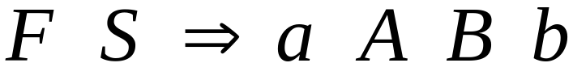
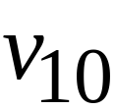

Slide 22

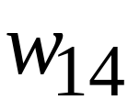
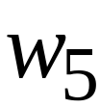
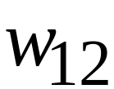
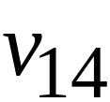

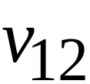

Slide 23
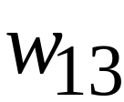

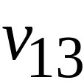


Slide 24
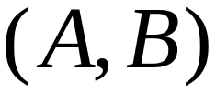
Theorem:
has an MPC-solution
if and only if

Slide 25
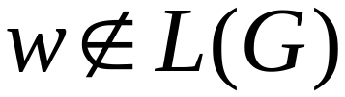
Algorithm for membership problem:
Input: unrestricted grammar
string
Construct the pair
If has an MPC-solution then
else

Slide 26
Membership machine
solution
construct
MPC
algorithm
No-solution

Slide 27
2. We will prove that the
PC problem is undecidable
We will reduce the MPC problem
to the PC problem

Slide 28
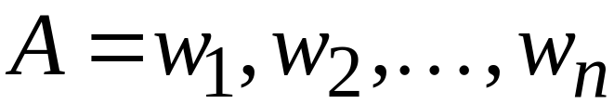
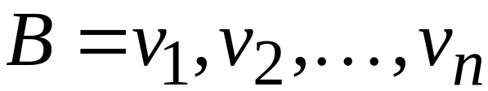
: input to the MPC problem

Slide 29

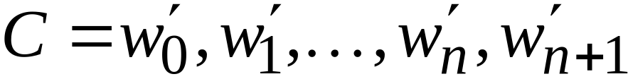
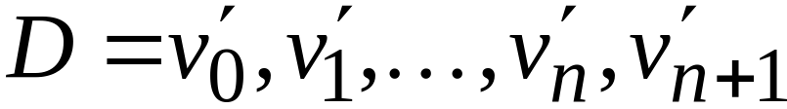
We construct new sequences

Slide 30

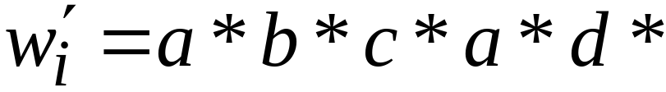
We insert a special symbol between
any two symbols

Slide 31
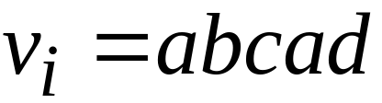

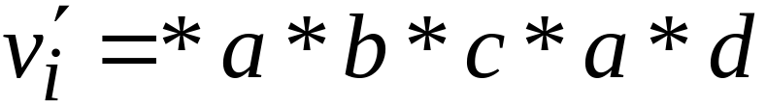

Slide 32
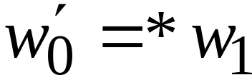
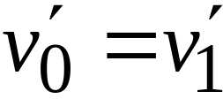
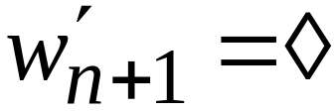
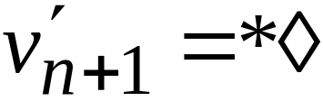
Special Cases

Slide 33
Observation:
There is a PC-solution for
if and only if
there is a MPC-solution for

Slide 34
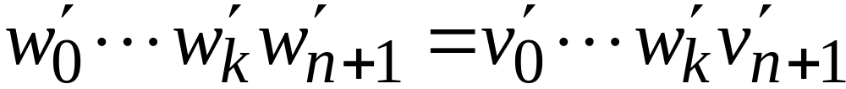
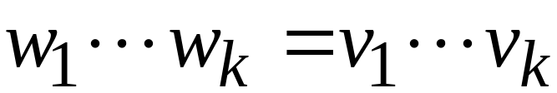
PC-solution
MPC-solution

Slide 35
MPC-algorithm
Input: sequences
Construct sequences
Solve the PC problem for

Slide 36
MPC algorithm
solution
construct
PC
algorithm
No-solution

Slide 37
The Church-Turing thesis
3.3.e
Giorgi Japaridze Theory of Computability
The Church-Turing thesis:
(the intuitive notion of) Algorithm
=
Turing machine
It can never been mathematically proven!
Importance: Without the Church-Turing thesis, you can never prove
that a certain problem has no algorithmic solution.
Example - Hilbert’s 10th problem (see page 154).

Slide 38
Church-Turing Thesis
As stated by Kleene:
  Every effectively calculable function (effectively decidable predicate) is general recursive.
“Since a precise mathematical definition of the term effectively calculable (effectively decidable) has been wanting, we can take this thesis ... as a definition of it...”
Yes, this is circular: everything calculable can be computed by a TM,
and we define what is calculable as what can be computed by a TM.

Slide 39
Church-Turing Thesis
Any mechanical computation can be performed by a Turing Machine
There is a TM-n corresponding to every computable problem
We can model any mechanical computer with a TM
The set of languages that can be decided by a TM is identical to the set of languages that can be decided by any mechanical computing machine
If there is no TM that decides problem P, there is no algorithm that solves problem P.
All of these statements are implied by the Church-Turing thesis

Slide 40
Examples
[Last class and PS4] Equivalence of TM and 2-stack deterministic PDA + ε-transitions
[PS4] Making the tape infinite in both directions adds no power
[Soon] Adding a second tape adds no power
[Church] Lambda Calculus is equivalent to TM
[Chomsky] Unrestricted replacement grammars are equivalent to TM
[Takahara and Yokomori] DNA is at least as powerful as a TM
[Hotly Debated] Is the human brain equivalent to a TM?
“Some of these models are very much like Turing machines, but others are quite different.” (not such a bogus sentence)

